Slide 1
Customer Analytics and Revenue Forecasting
A data scientist project by pooja sharma

Slide 2
PROBLAM STATEMENT
The Company is facing challenges in branding and revenue generation.
There is a need to analyse customer behaviour and campaign performance.
The objective is to improve business decisions using data-driven insights.

Slide 3
OBJECTIVES
To analyse customer profiles and preferences.
To evaluate campaign success and failure.
To identify revenue trends across different regions.
To forecast future income using machine learning techniques.
To segment customers using clustering methods.

Slide 4
DATA DESCRIPTION
The dataset contains 3 years of historical data.
It includes customer , campaign , and store information.
Data is collected from multiple regions and states.
The dataset is masked due to NDA from confidentiality.

Slide 5
TOOLS USED
Python for data cleaning and machine learning.
Power BI for data visualization and dashboard creation.
SQL for database management and querying.
Excel as the data source.

Slide 6
PROCESS FLOW
Data Collection.
Data Cleaning and Preparation.
Data Analysis.
Data Visualization using Power BI.
Forecasting and Clustering.
Generating Insights.

Slide 7
DATA CLEANING
Handled missing values in the dataset.
Removed duplicate records.
Converted data into proper formats.
Prepared clean and structured data for analysis.

Slide 8
DASHBOARD OVERVIEW
Customer Overview Dashboard.
Revenue Analysis Dashboard.
Campaign performance Dashboard.
Product Insights Dashboard.
Regional Analysis Dashboard.

Slide 9
KEY INSIGHTS
West region contributes the highest revenue.
Social media campaigns show higher success rates.
Customers aged between 25-35 are the most active segment.
Certain product have consistently higher demand.

Slide 10
FORECASTING
Applied Linear Regression model for prediction.
Forecasting customer income for the next 2 years.
Analysed trends based on historical data.
Help in future business planning and decision-making.

Slide 11
CLUSTERING ANALYSIS
Applied K-Means clustering technique.
Segmented customers into different groups.
Identified high-value , medium-value , and low-value customers.
Help in targeted marketing and better decision-making.

Slide 12
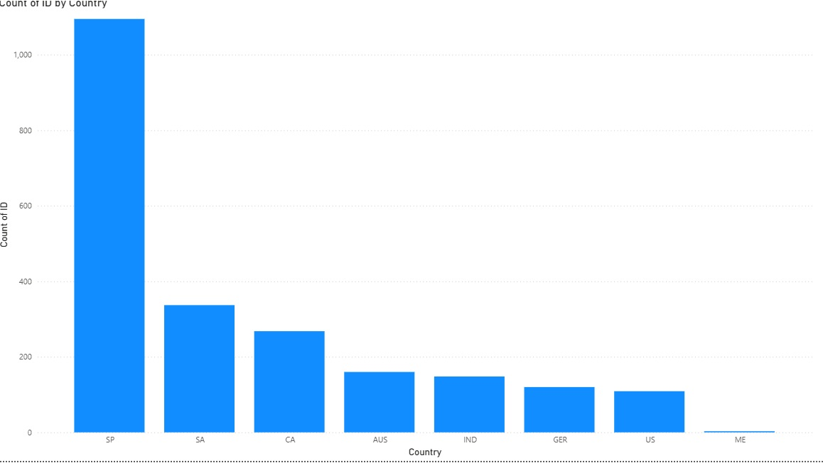
INCOME DSHBOARD

Slide 13
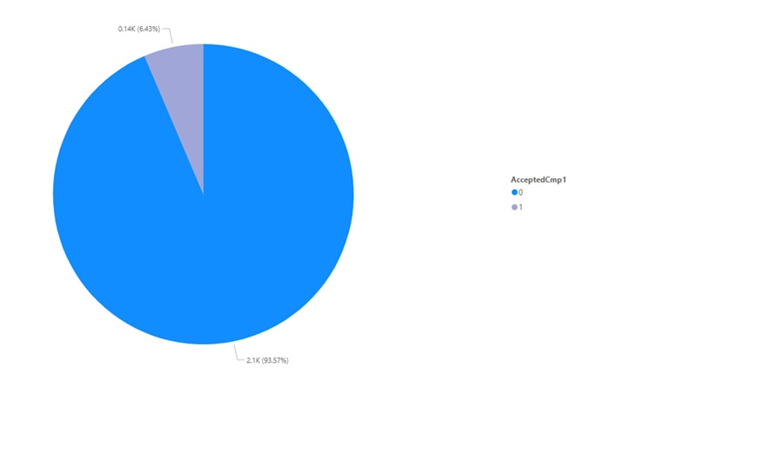
CAMPAIGN DASHBOARD

Slide 14
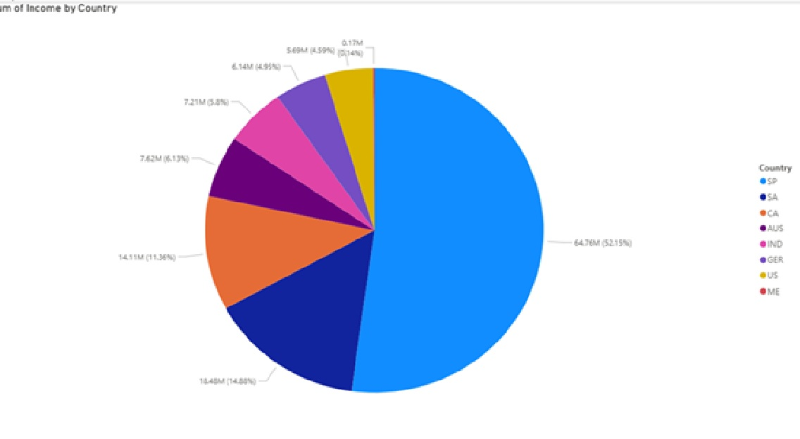
COUNTRY DISTRIBUTION

Slide 15
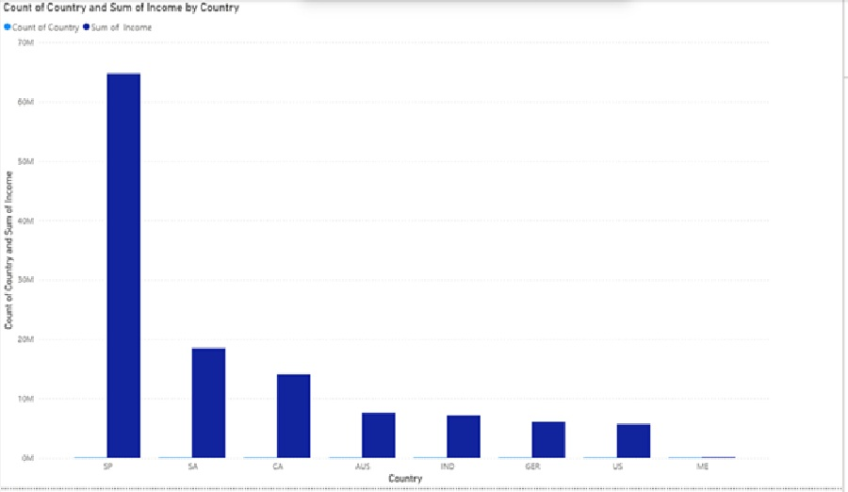
CUSTOMER COUNT

Slide 16
CONCLUSION
Data analysis helped in identifying key business insights.
Campaign performance can be improved based on findings.
Customer segmentation helps in targeted marketing.
Forecasting supports better future planning.

Slide 17
THANK YOU
Thank you

